Slide 1
Unit 6 Sequence and Series

Slide 2
Advance organizer
Learning objectives:
Understand 9.2 Arithmetic Sequence
Prior knowledge:
Understand 14.7 Double-Angle and Half-Angle Identities
Successful criteria:
Controlled Practice: Complete the Exit Card
Freer Practice: Complete questions to your interest
Learning activities:
1. Skim the text and examples (15 mins)
2. Understand the presentation (35 mins)
3. Complete the Exit card (25 mins)
4. Summaries the main idea and reflect (5 min)

Slide 3
Key terms:
Sequence [序列]: An ordered list of numbers.
Series [级数]: The sum of all the terms in a sequence.
Arithmetic Sequence [等差数列]: A sequence where the difference between any two consecutive terms is constant.
Common Difference [公差]: The constant value added (or subtracted) between any two consecutive terms in an arithmetic sequence.
Arithmetic Mean [算术平均数]: The sum of all terms in a sequence divided by the number of terms.

Slide 4
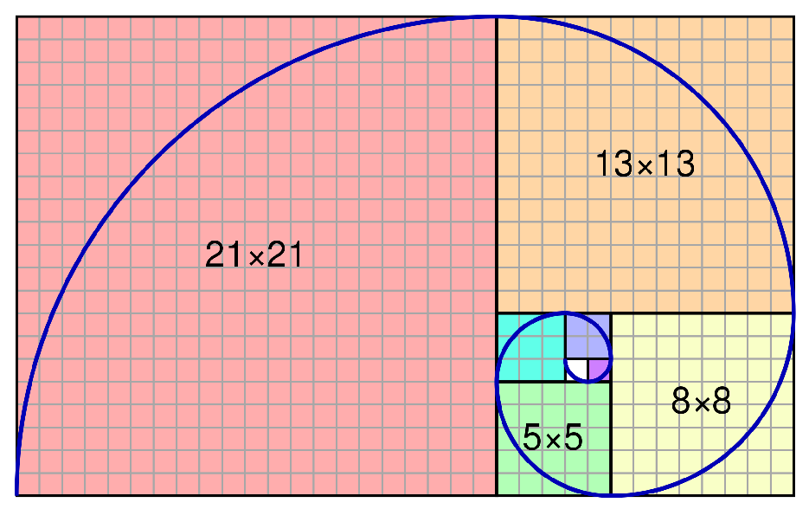
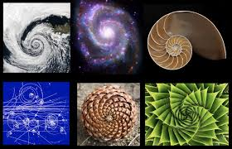
The Fibonacci Sequence
The sequence follows the rule that each number is equal to the sum of the preceding two numbers. The Fibonacci sequence begins with the following 14 integers: 0, 1, 1, 2, 3, 5, 8, 13, 21, 34, 55, 89, 144, 233 ..

Slide 5
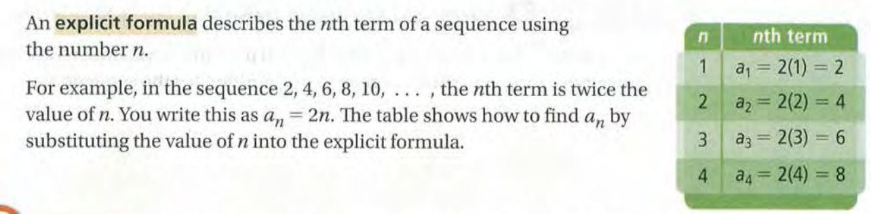
Explicit Formula

Slide 6
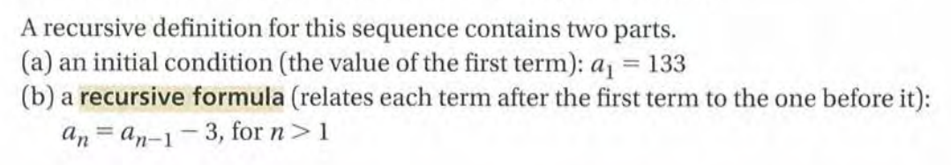
Recursive Formula

Slide 7
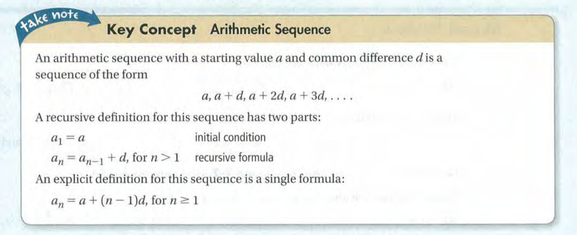

Slide 8
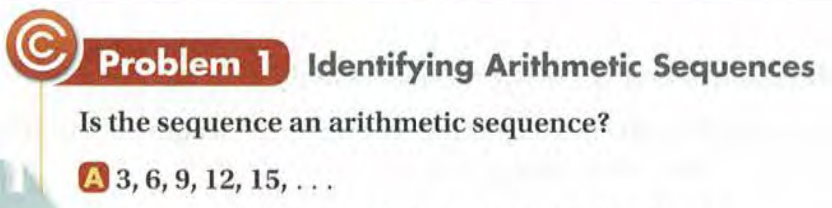


Slide 9


Slide 10
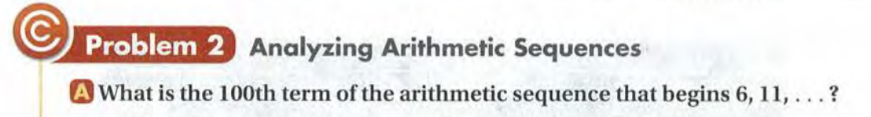

Slide 11
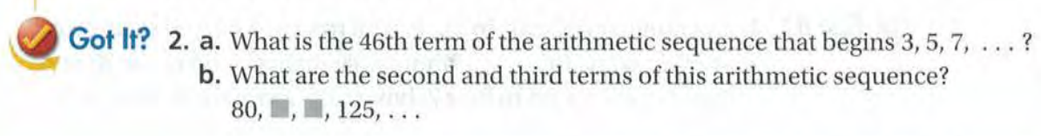

Slide 12
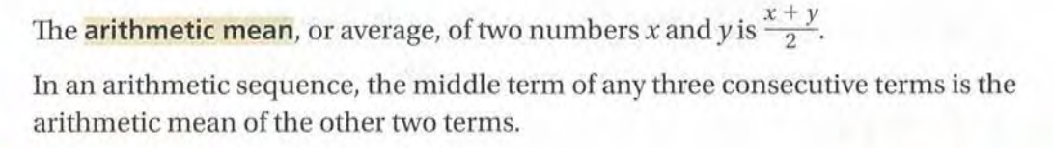
Arithmetic Mean

Slide 13
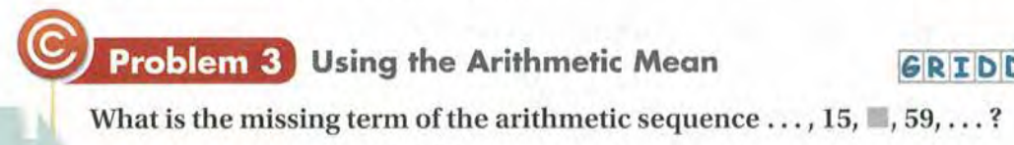
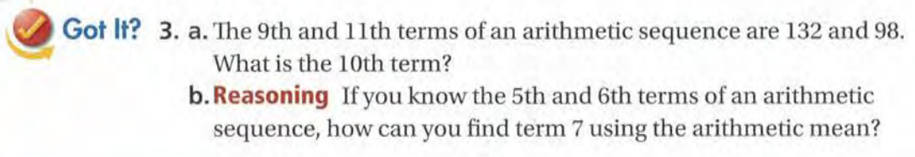

Slide 14
Exit Card:
Complete the “Arithmetic Sequence” Learning sheet!

